Slide 1

Netzwerk Academy
Presented by : Anirudh Nayak

Slide 2
KNN ALGORITHM
K-Nearest Neighbor is one of the simplest Machine Learning algorithms based on Supervised Learning technique.
K-NN algorithm assumes the similarity between the new case/data and available cases and put the new case into the category that is most similar to the available categories
K-NN algorithm can be used for Regression as well as for Classification but mostly it is used for the Classification problems.
It is also called a lazy learner algorithm because it does not learn from the training set.

Slide 3
K in KNN
K represents the number which used to identify similar neighbor based on the feature similarity.
KNN takes K nearest neighbors to decide where the new data point with belong to.
K value must not be equal to 1

Slide 4
Steps in KNN
Step 1 : Choose the value of k which must be a odd number
Step 2 : Find the distance between newly given data and each of the data points of training data
Step 3 : Find Knn to new data point
Step 4 : Count the number of data points into each category among k neighbors and data point will be classified based on maximum number of neighbors

Slide 5
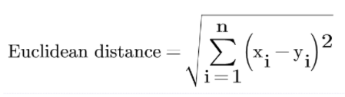
Distance Calculation in Knn
Euclidian distance Formula:
Euclidean Distance Is A Method To Calculate The Distance Between Two Points In Space. This Formula Gives The Shortest Path Between The Two Points

Slide 6
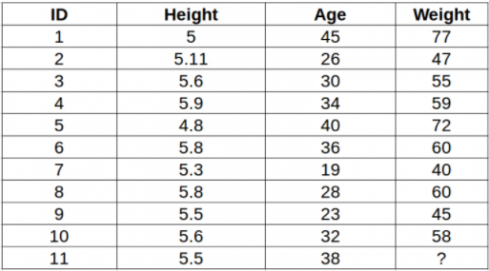
Example for Knn
We consider a table which consists of the height, age and weight value for 10 people. We need to predict the weight of 11th person based on their height and age.

Slide 7
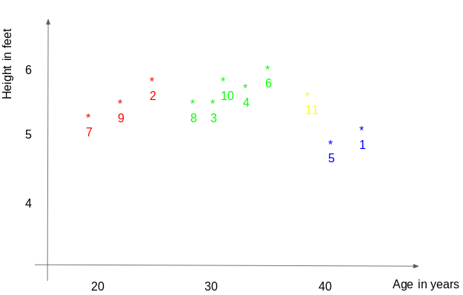
For a clear idea, consider this graph

Slide 8
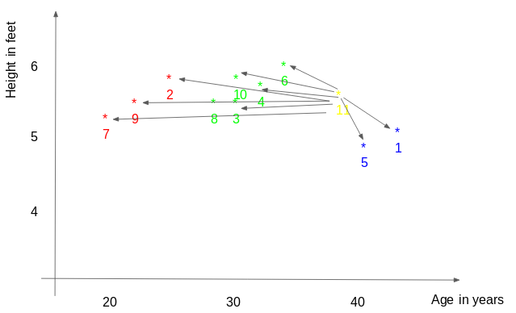
Steps in KNN
Step 1 : distance between the new point and each training point is calculated.

Slide 9
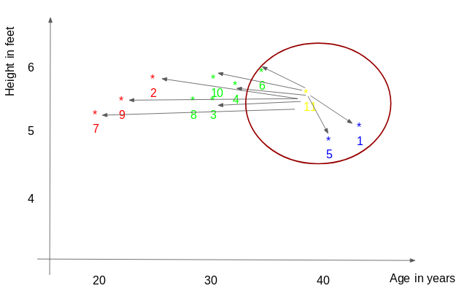
Step 2 : The closest k data points are selected. In this example, points 1, 5, 6 will be selected if the value of k is 3.

Slide 10
Step 3 : The average of these data points is the final prediction for the new point. Here, we have weight of ID11 = (77+72+60)/3 = 69.66 kg.

Slide 11
Thank You

